Slide 1
On Your Mark, Get Ready,…SCOPE!
“The farther back you can look, the farther forward you are likely to see.”
-Winston Churchill
Brad Eldridge, KYTC
Notes:
Why giving presentation? Tools, tips, new design manual, ….
Why important- understanding of project needs & what it is supposed to deliver, save on time/money, redoing plans, overview of design manual,
Overview-HDM 202 Pre-Design Activities and touch on Key Decision Pts at beginning of HD-203, Preliminary Design.
As an audience-PM can use to prepare and consultants can use when preparing proposals
ALL BEFORE ADVERTISING

Slide 2
Project Scope
Project scope is the part of project planning that involves determining and documenting a list of specific project goals, deliverables, tasks, costs and deadlines.
A series of project-focused activities that develop key design parameters and other project requirements.
Notes:
Activities to a sufficient level of definition such that scope and delivery is complete and a budget and project completion date can be accurately established to minimize the risk of significant change and project overruns.
Project Scope: The work that needs to be accomplished to deliver a product, service, or result with the specified features and functions.
Scope in Project Management: The process of obtaining information required to commence a particular project and using such information to create a detailed description of the project and product. It also involves knowing about the features of the product that will meet the requirements of the stakeholder.

Slide 3
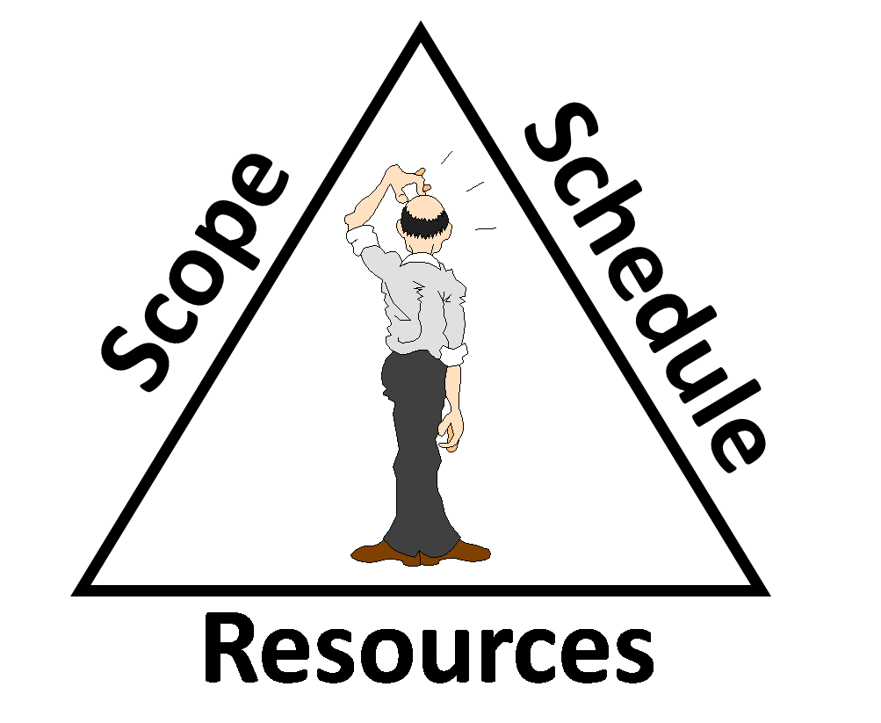
Triple Constraint
Notes:
Resources include budget, human resources, etc.
What happens if the work to develop a more defined scope increases?

Slide 4
NCHRP Report 821 Effective Project Scoping
Statistical Evidence indicates that earlier and more detailed scoping efforts can reduce total design and construction cost by as much as 20% and shorten total design and construction schedule by as much as 39%.
Notes:
This report takes scoping all the way to preferred alternate.
Mac Yowell quote $1 to $7
Another benefit of well defined scope is that it can alleviate scope creep
Allocate proper amount of time for size and complexity of each project. (Flexibility)
Flexible process-smaller or simpler projects may not need same time and effort to achieve adequate scope

Slide 5
Notes:
Who has experienced this?
May compare building a road to building a house

Slide 6
STEPS TO EFFECTIVE SCOPING
Project Data
Resource Determination
Pre-Design Meeting
Key Decision Points
Notes:
MEAT OF PRESENTATION
Official New HDM signed and approved 3/27/17.
Short version of table of contents that can link to as well
Different links provided in respective sections for these Pre-Design Activities
Parallel graphic representative to show how it builds upon itself. Note that an estimate is determined that should align with budget. **Nice if preliminary engineering and environmental was a program so an estimate could support the budget.
Pre-design meeting is not the Predesign conference meeting held with consultant. This meeting is held by PDM to review issues faced by the project. Would encourage minutes to this meeting and will elaborate later.

Slide 7
Notes:
HDM Table of Contents-link to sections and links in sections. Above is cut out of Project Data.
Planning Study section- like DNA and include Preliminary Cost Estimate worksheet. Excel worksheet is also on KYTC intranet site. Created by Keith Damron. Includes all phases. Will see in a bit.
For crash data may consider the flexible design or bottom up approach. Some projects may not have crash problems or can be mitigated with little effort.
What are some other items to consider? - besides stakeholder input from PRUC maintenance may include elected officials, residents, sponsor, ….who else???

Slide 8
Notes:
Contains Project Identification, existing project data, P&N, env overview, utility contacts, and an estimate.
P&N is broken into factors to help establish need for a proposed action. Breakout on P&N. Data driven and emphasize data that is current and factual and supports why project is being pursued. Example: If data shows safety is not an issue then do not list in P&N. Potentially unsafe or hazardous is not a need. May be need is mainly improving capacity.

Slide 9
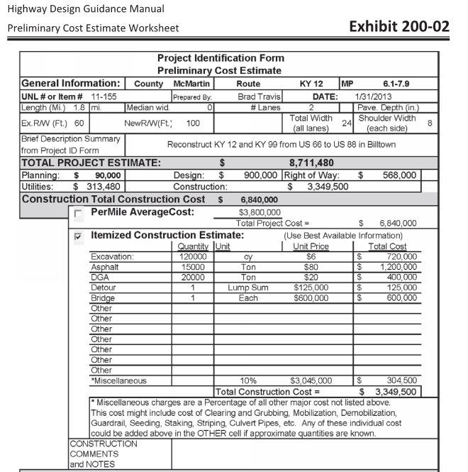
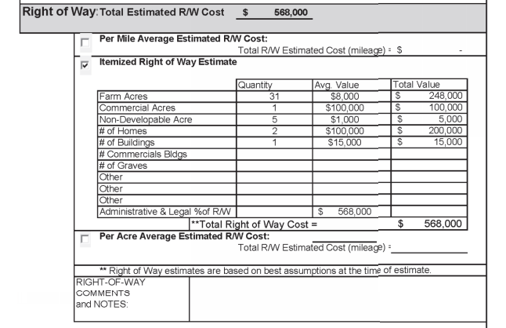
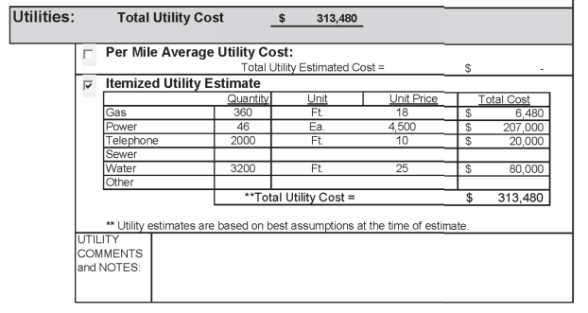
Notes:
For preliminary scoping estimate consider contingencies which typically range from 25-35% and type of structure, number of spans, pier heights, number of beams, proposed deck square foot, approach work. May also consider other cost assumptions an risks
Where can get information?? LiDAR, Google Earth, site visit, PVA online or courthouse, interviews, GIS, ….

Slide 10
RESOURCE DETERMINATION
Project Schedule
Milestones
Impact mitigation
Difficulty obtaining right of way
Utility Relocation
Notes:
Back in schedule from approved plan- especially R/W fiscal year
Understanding of acquisition challenges, utility conflicts, etc.
In-house (DO, other DO, CO), on call services (statewide), advertise or combination?

Slide 11
Project Authorization
Initial design authorization-Design Funds Documentation Summary Form.
What items are needed to develop project
Who will be performing what services
Indication of Production Hours due anticipated expenditures
Notes:
See HD website for most current forms-This form breaks down items and state/consultants?

Slide 12
Pre-Design Meeting
Purpose and Need
Project Scope
Schedule and Milestones
Additional Resources
Additional Mapping
Environmental Overview
Traffic Forecasting
Public Involvement
Notes:
Please note that this is not the Pre-design conference held with the consultant after they have been selected. District 9 call this the Red Flag Meeting. Used to discuss items as the name implies.
Invite appropriate Subject Matter Experts including construction and maintenance.
Encourage site visit or at least us Google Earth, GIS, etc.
Project Scope- Will talk about more on next slider. Can lead to what guidance documents to refer to like GB, Low Volume, HCM, HSM, 3r Special Report 214, etc.
For schedule and milestones- 1st is alternative concepts which is brainstorming. Consider all types of ideas that meet the P&N. Should be without a preference.
Env Overview-air, aesthetics, cemeteries, cultural resources, endangered species, federal lands, floodplains, groundwater resources, HazMat/UST, 4f & 6f, Socio Econ and EJ, streams, wetlands
Good to get public involvement early

Slide 13
Developing a project scope
Type of Project
Project Description
Draft Purpose and Need
Roadway Characteristics
Potential Options to Consider
Design Criteria
Proposed Access Control
Possible Funding Types
Potential Environmental Actions
Right of Way Requirements
Number of Drainage Structures Anticipated
Notes:
ACCEPTANCE CRITERIA FOR PROJECT TO BE CONSIDERED SCOPED
Verify project description with PIF, Precon Database (report), DNA, etc. Includes location, length, mile points, etc.
This list also mirrors list of what is needed to advertise for consultant services in HD 205.2
Design Criteria-think bottom up
For right of way also consider needs for utility relocation
May need a Scope Verification Meeting for Federal Projects that are anticipated as CE LV 3 and above.
At this point may advertise for consultant services. Guidance is provided in HD 205.2 for information need to advertise project which includes scope and typically a DNA or equivalent.

Slide 14
Key Decision Points
Purpose and Need
Public Meeting
Range of Alternatives
Scope of Impacts
Public Meeting
Select Preferred Alternative
Notes:
Public input may be need to develop P&N
Alts should be reasonable & competitive. Would expand competitive to include unique-lt, rt, up middle (best alt up front not combo like alt 1-2B), small quick fix vs ultimate, etc
Preferred alternative should meet P&N, be possible, practical, & feasible, integrate env & design, understandable, reasonable, defensible,
Need an alternate within sched and budget. Include No Build. Bottom up design may have a maintenance type application. Bridge replacement examples of bypass, buyout, closing, etc.
Scope of impacts summarizes SME input like env, R, & U and the risks associated with each alternate and the time to resolve possible issues. The output may include a draft EA or CE, prelim alts, R&U impacts with costs, possible mitigation measures, possible project costs and schedule impacts
Preferred alt characteristics-understandable, defensible, avoid delays to sched, rationale, …

Slide 15
A Solution In Search of a Need?
Notes:
With all that said want to avoid this…..
When scoping besides “standards”, consider balancing engineering, environment, & economics. This is in line with Context Sensitive Design. Maintain flexibility when designing. Also consider basic needs of project. Consider a bottom up approach.
Sometimes straight, wide, and flat is not always safer.
Main point, allow time for proper scoping. It will pay off in the future. Maybe 20% $ and 39% time

Slide 16
“BY FAILING TO PREPARE, YOU ARE PREPARING TO FAIL.”
-BENJAMIN FRANKLIN
Notes:
Thank you. Questions???

